Slide 1
Adventure Works Sales & Performance Analysis End-to-End Business Intelligence Project
created By
Jogendernath Kompalli

Slide 2
About Adventure Works
Company Overview
Adventure Works is a multinational bicycle manufacturing company that sells bicycles and related accessories across different regions. The company aims to improve sales performance, customer satisfaction, and profitability using data-driven decision making.
Project Objectives
Clean and prepare sales data
Integrate multiple datasets
Build an analytics-ready database
Create interactive dashboards
Generate meaningful business insights

Slide 3
Project Workflow
Raw Excel Files
↓
Excel Data Cleaning
↓
MySQL Data Transformation
↓
FactSales_Combined Table
↓
Tableau Dashboard
↓
Power BI Dashboard
↓
Business Insights

Slide 4

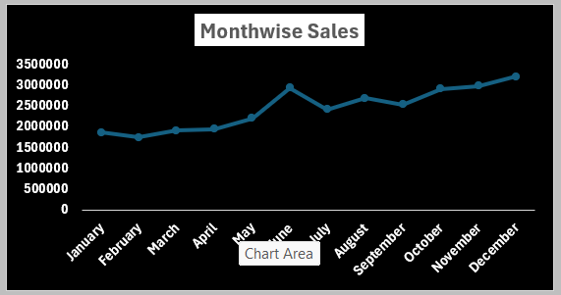
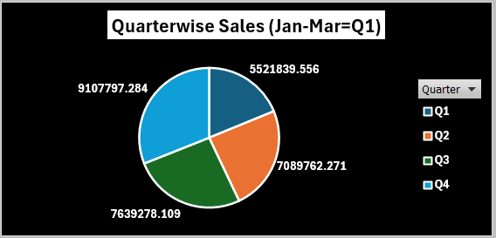
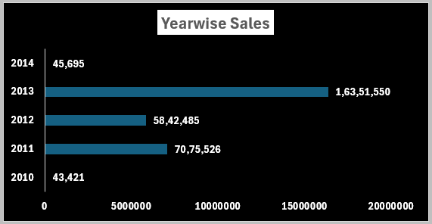
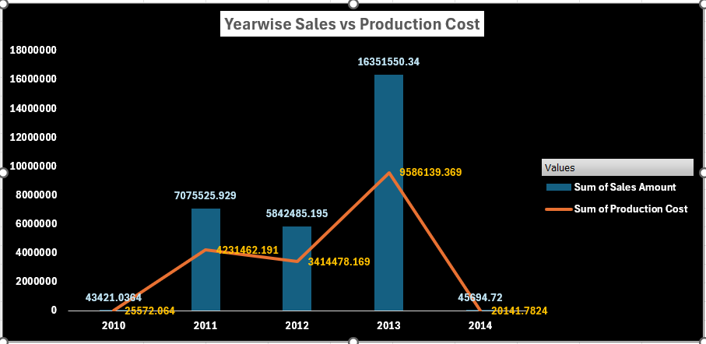
Excel Implementation
Activities Performed
Combined Fact Internet Sales datasets
Performed Product and Customer lookups
Created calculated columns
Cleaned missing values
Created Pivot Tables
Built interactive dashboards
Dashboards
Sales Report
Regional Report
Sales vs Production Cost

Slide 5
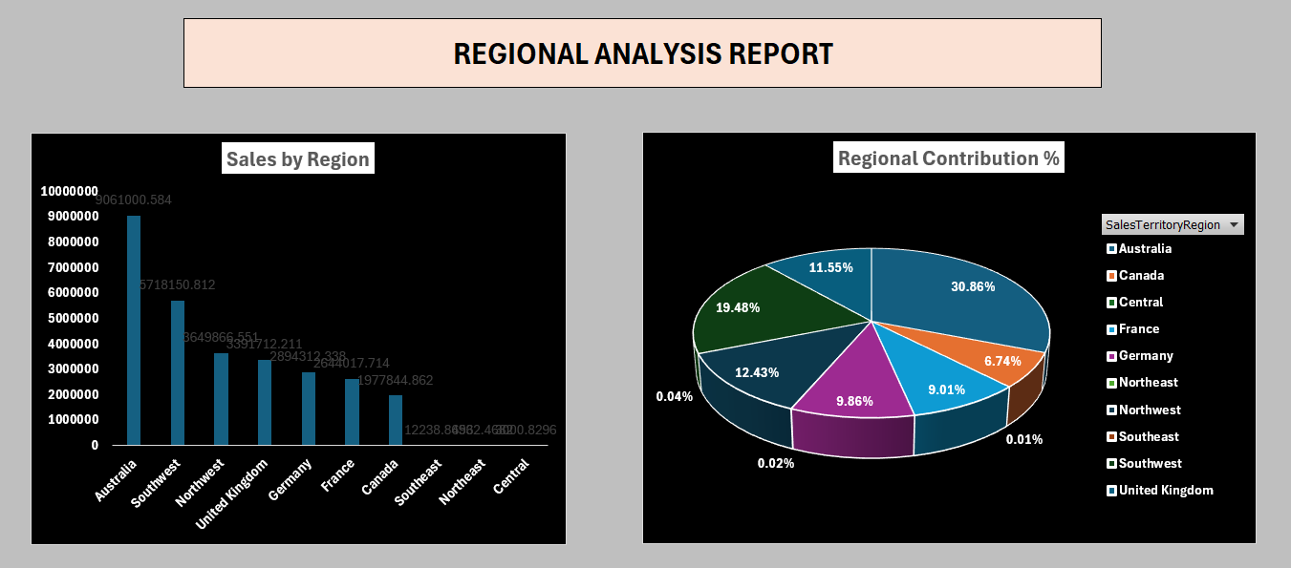
Excel Dashboard Analysis
Key Insights
Australia generated the highest sales.
Sales increased significantly during 2013.
Quarterly analysis helped identify seasonal sales trends.
Regional dashboards highlighted the contribution of each sales territory.

Slide 6

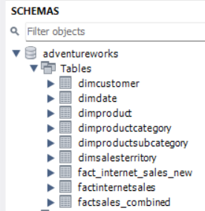
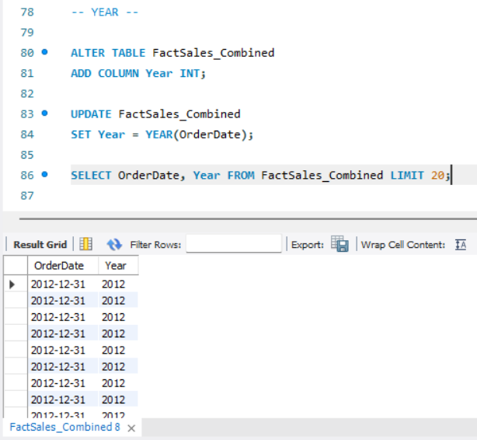
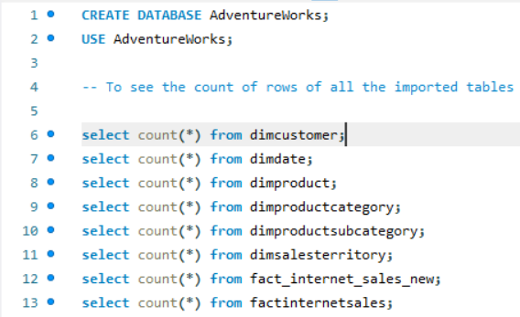
MySQL Implementation
SQL Operations
Imported Adventure Works datasets
Combined FactInternetSales and Fact_Internet_Sales_New
Created FactSales_Combined table
Added Product Name and Customer Name
Converted OrderDateKey to Date
Created:
Year
Month
Month Name
Quarter
Financial Month
Financial Quarter
Verified Sales Amount
Verified Production Cost
Calculated Profit

Slide 7
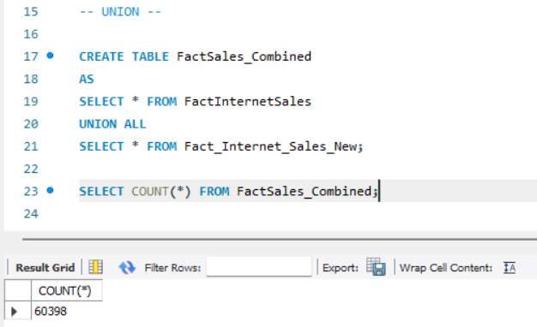
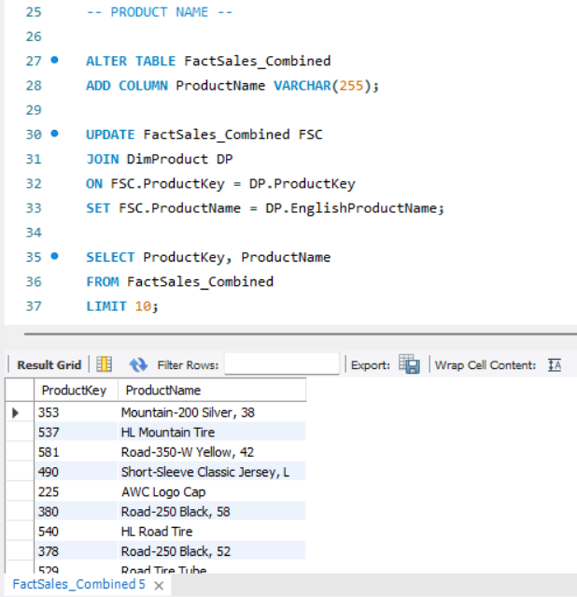
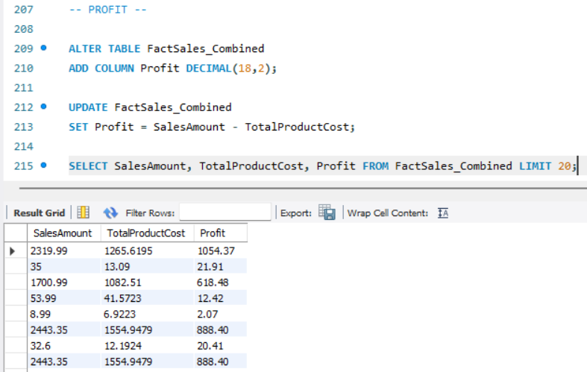
SQL Query Highlights
Sample SQL Operations
UNION of sales tables
JOIN operations
UPDATE statements
Profit calculation
Financial Quarter calculation
Data verification using SELECT queries
Outcome
Prepared an analytics-ready dataset for visualization.

Slide 8

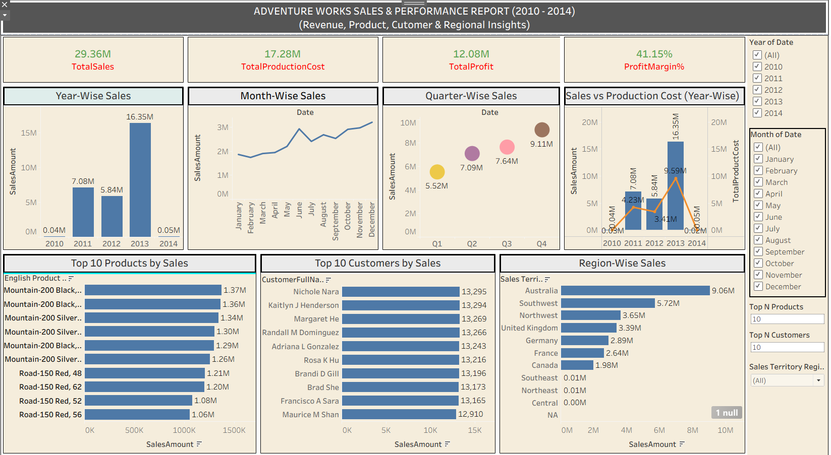
Tableau Dashboard
Dashboard Features
Interactive Filters
KPI Cards
Sales Trend Analysis
Product Performance
Customer Analysis
Region-wise Sales
Time-based Analysis
This Photo by Unknown Author is licensed under CC BY-SA

Slide 9

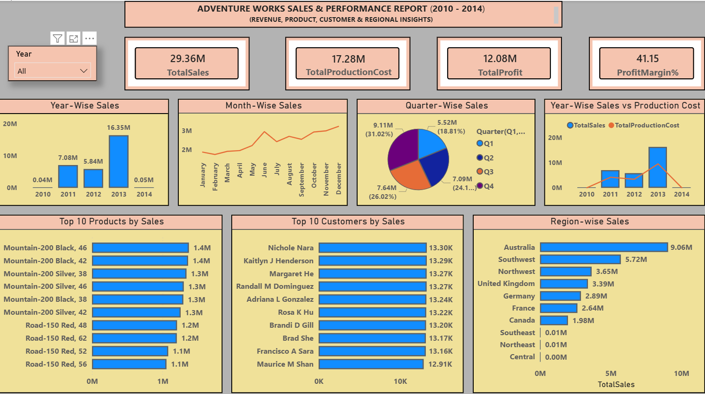
Power BI Dashboard
Dashboard Features
KPI Cards
Sales Trend
Sales vs Production Cost
Top Products
Top Customers
Regional Performance
Interactive Slicers
DAX Measures

Slide 10
Business Insights
Key Findings
Australia achieved the highest revenue.
2013 recorded the maximum sales.
Mountain product category contributed significantly to revenue.
Profit Margin remained above 40%.
Regional dashboards supported sales performance evaluation.
Interactive dashboards enabled faster business decision making.

Slide 11
Skills Demonstrated
Technical Skills
Microsoft Excel
MySQL
Tableau
Power BI
SQL Queries
ETL Process
Data Cleaning
Data Visualization
Dashboard Design
Business Intelligence

Slide 12
Challenges & Solutions
Challenge
Importing large datasets
SQL transformations
Date conversions
Dashboard creation
Solution
Combined and validated data successfully
Used JOIN, UPDATE and calculated fields
Derived Year, Month, Quarter and Financial attributes
Built interactive visualizations in Tableau and Power BI

Slide 13
Conclusion
This project demonstrated the complete Business Intelligence lifecycle—from data preparation and transformation to interactive dashboard development. Using Excel, MySQL, Tableau, and Power BI, the project delivered meaningful business insights and strengthened practical skills in data analysis, visualization, and reporting.

Slide 14
Thank You
Adventure Works Sales & Performance Analysis
Prepared by
Jogendernath Kompalli
Turning Data into Actionable Business Insights

